Slide 1
Isotope ratio mass spectrometry: Basic principles and applications
MENVIPRO Summer School

Slide 2
The isotope ratios of chemical elements
²H/¹H ¹³C/¹²C ¹⁸O/¹⁶O ¹⁵N/¹⁴N ³⁴S/³²S
¹³C /¹²C
(¹³C /¹²C)₁

Slide 3
Isotope ratio mass spectrometry
IRMS
Floyd Landis
www.stuff.co.nz/sport/other-sports/3721622/Floyd-Landis-admits-Tour-de-France-doping

Slide 4
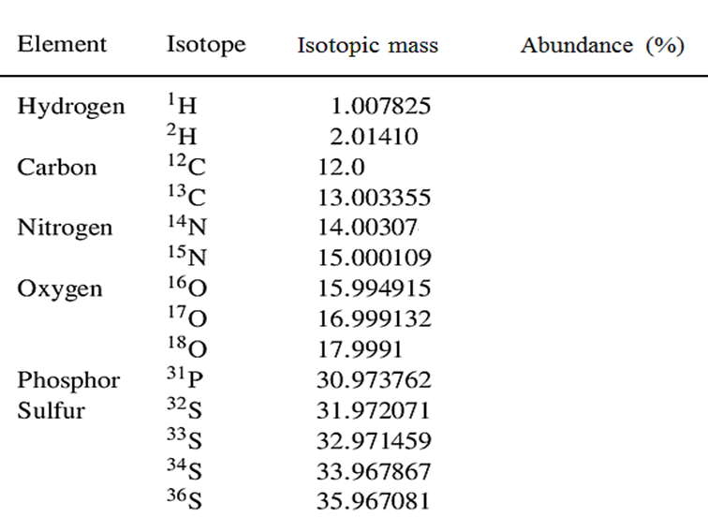
100
0.0115
100
1.08
100
0.369
100
0.038
0.205
100
100
0.80
4.52
0.02
IUPAC 2001

Slide 5
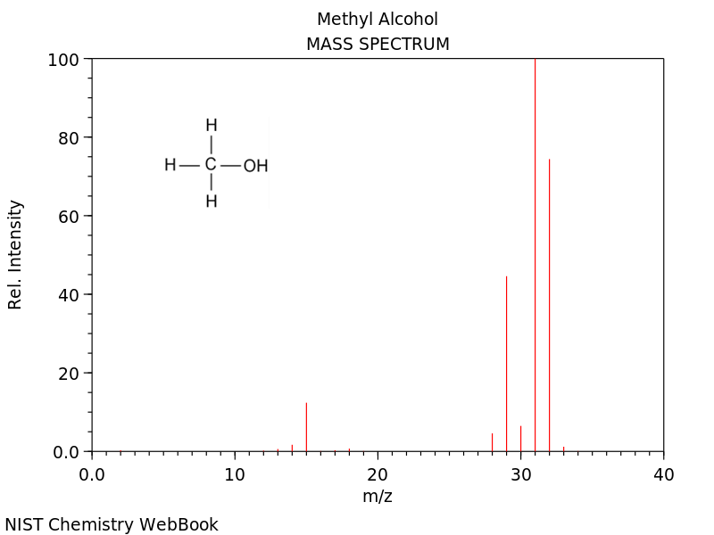
base peak

Slide 6
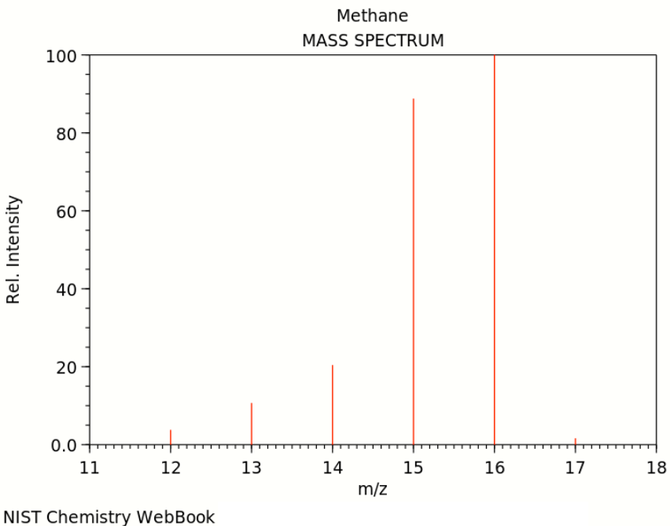
Isotopologues
¹²CH₄
¹³CH₄
methane
+.
CH₄
+
CH₃
+.
CH₂
+
CH
+.
C

Slide 7
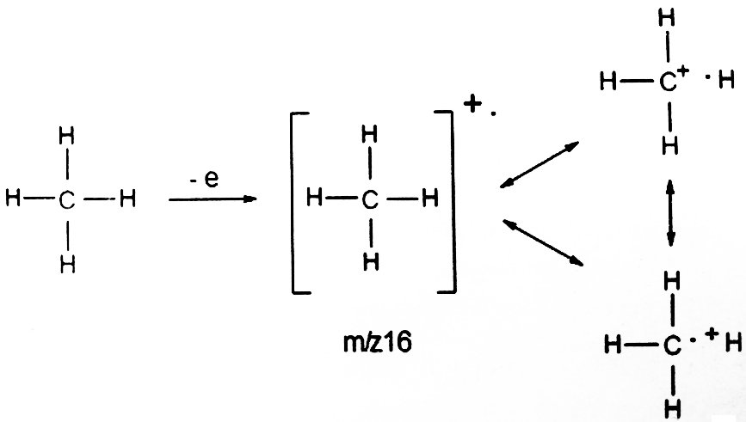
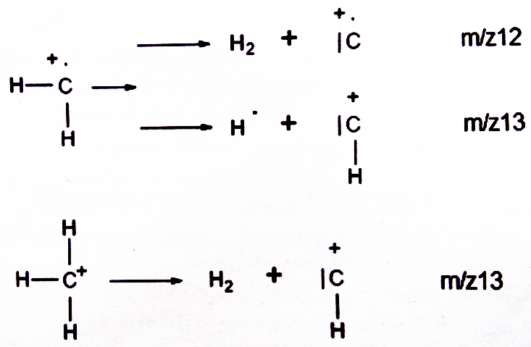
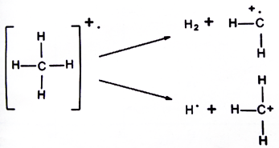

Slide 8
Isotopic pattern of carbon
100 %
 | Atomic No. | Mass No. | Natural abundance %
C | 6 | 12 | 100
 |  | 13 | 1.1
+.
CH₄
1.1%
+.
¹³CH₄

Slide 9
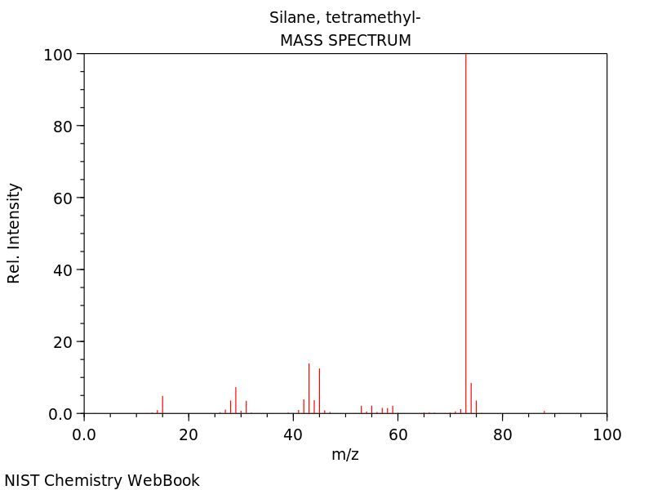
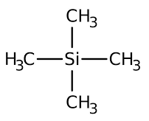
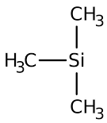
73
+.
M = 28 + 4 x 15 = 88 Da
74
+
.
75
88
trimethylsilyl ion
M = 73 Da
Mass Spectrometry; Basic Principles and Applications, Ketevan Lomsadze, TSU press, 2015

Slide 10
C₃H₉Si
100%
 | Atomic No. | Mass No. | Natural abundance %
Si | 14 | 28 | 100
 |  | 29 | 5.0778
 |  | 30 | 3.3473
+
trimethylsilyl ion
M = 73 Da
8.4%
3.39%
C | X | X + 1 | X + 2
1 | 100 | 1.1
2 | 100 | 2.2 | 0.01
3 | 100 | 3.3 | 0.04
X + 3
73
75
9 | 100 | 9.7 | 0.42
30 | 100 | 32.3 | 5.0
0.5
¹³C ¹²C₂H₉Si (3.3%)
¹³C ¹³C ¹²CH₉Si (0.04%)
C₃H₉²⁹Si (5.1%)
C₃H₉³⁰Si (3.35%)

Slide 11
Delta notation
X 1000
‰
Isotope ratio of the sample
Isotope ratio of the international standard (defined by the IAEA)
IAEA - International Atomic Energy Agency

Slide 12
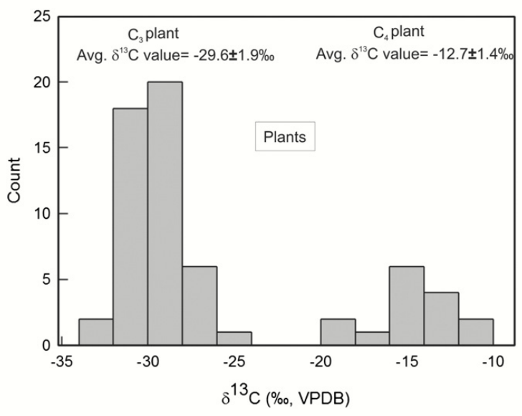
C₃ plants
Flowering plants
Wheat
Rice
Rye
Cotton
C₄ plants
Sugar cane
Corn
Tropical grasses
Desert plants
Marine plants
Sayak Basu, Shailesh Agrawal, Prasanta Sanyal, Poritosh Mahato, Satyam Kumar, Anindya Sarkar, Carbon isotopic ratios of modern C3–C4 plants from the Gangetic Plain, India and its implications to paleovegetational reconstruction, Palaeogeography, Palaeoclimatology, Palaeoecology, Volume 440, Pages 22-32, 2015

Slide 13
Verification of wine authenticity
1. Identification of addition of water;
2. Identification of addition of sugars;
3. Recognition of the geographic provenance.
sugar cane
sugar beet

Slide 14
Isotope ratio mass spectrometer
Electron ionization (EI)
ion source
Magnetic sector
mass analyzer
sample
inlet
ion source
mass
analyzer
detector
data system
Continuous flow
(CF) intel system
Dual-intel (DI)
system
Faraday cup detector array (FCDA)
Elemental analyzer
Gas chromatograph
Separation techniques
Liquid chromatograph

Slide 15
CO₂
 | Atomic No. | Mass No. | Natural abundance %
O | 8 | 16 | 100
 |  | 17 | 0.038
 |  | 18 | 0.205
¹²C ¹⁶O ¹⁶O 44 Da
¹³C ¹⁶O ¹⁶O
45 Da
¹²C ¹⁷O ¹⁶O
¹²C ¹⁸O ¹⁶O 46 Da
 | Atomic No. | Mass No. | Natural abundance %
C | 6 | 12 | 100
 |  | 13 | 1.1

Slide 16
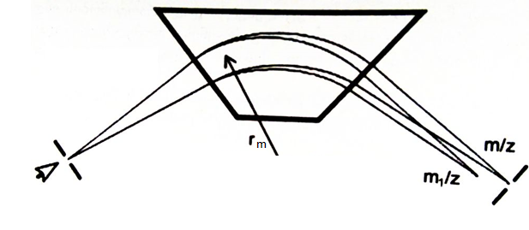
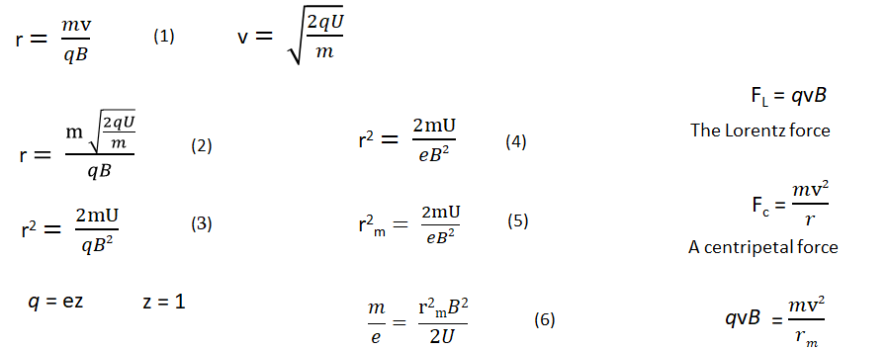
ion beam
trajectory
magnetic
analyzer
ion beam
detector

Slide 17
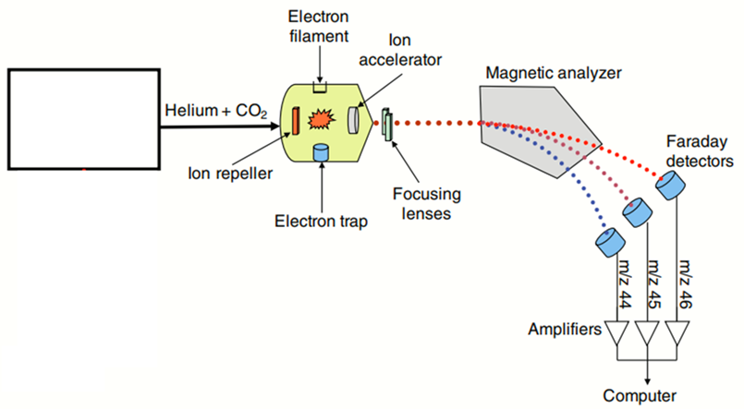
Sample
introduction
system
Muccio and Jackson (2009) Analyst 134: 213-222

Slide 18
CO₂
CO
N₂
¹²C ¹⁶O ¹⁶O 44 Da
¹²C ¹⁶O 28 Da
¹⁴N ¹⁴N 28 Da
¹³C ¹⁶O ¹⁶O
¹³C ¹⁶O
¹⁵N ¹⁴N
29 Da
45 Da
29 Da
¹²C ¹⁷O ¹⁶O
¹²C ¹⁷O
¹⁵N ¹⁵N
30 Da
¹²C ¹⁸O ¹⁶O 46 Da
¹²C ¹⁸O 30 Da
 | Atomic No. | Mass No. | Natural abundance %
N | 7 | 14 | 100
 |  | 15 | 0.369

Slide 19
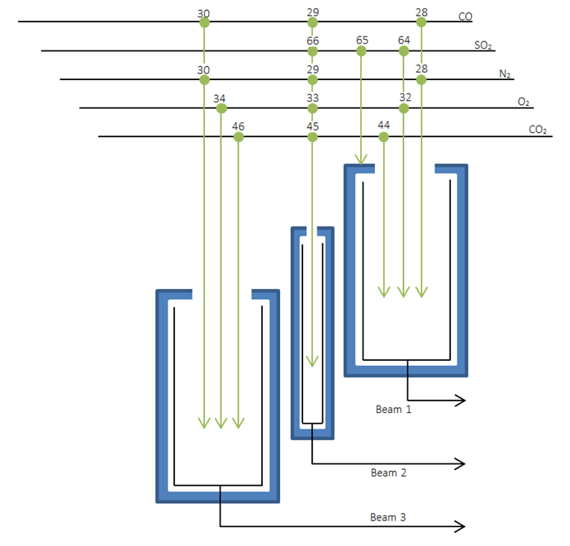
Faraday cup detector array
¹³C/¹²C
¹⁸O/¹⁶O
¹⁵N/¹⁴N
³⁴S/³²S
http://support.elementar.co.uk/documentation/Subsystems/precisION/precisION.htm#manuals/7._components_and_sub-assemblies/collectors/collectors_technical_description.htm

Slide 20
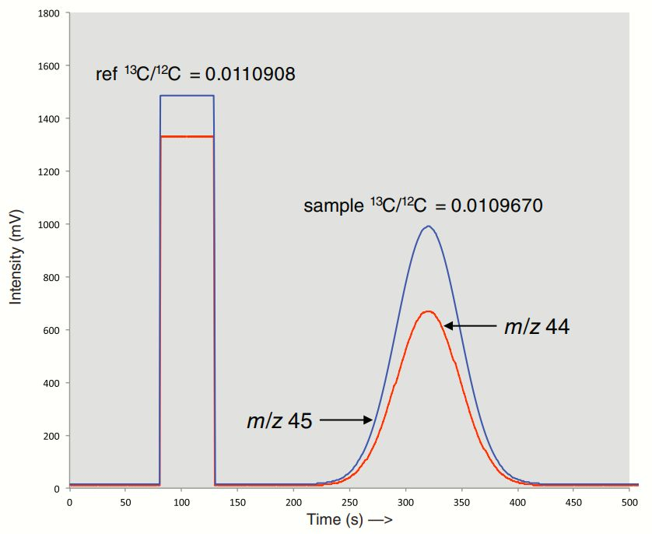
Lesley A. Chesson,
FORENSIC APPLICATIONS OF ISOTOPE RATIO MASS SPECTROMETRY,
Spectroscopy Solutions for Materials Analysis

Slide 21
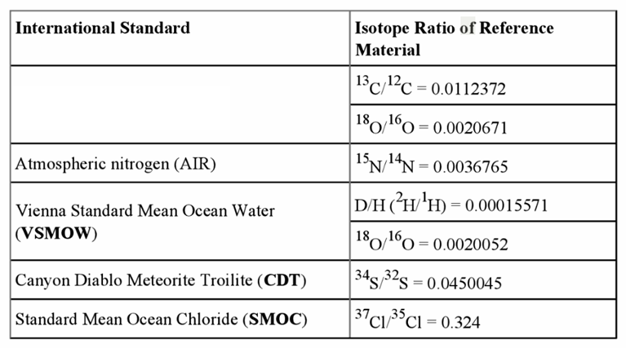
Vienna Pee Dee Belemnite (VPDB)
Benson, S., Lennard, C., Maynard, P., Roux, C., Forensic applications of isotope ratio mass spectrometry – a review.
Forensic Sci. Int., 157(1), 1-22, 2006

